Slide 1
FAM Diffusion: Frequency and Attention Modulation
for High Resolution Image Generation with Stable Diffusion
CVPR, 2025
2 citations
Samsung AI Center, University of Surrey

Slide 2
01. INTRODUCTION
02. METHOD
03. EXPERIMENTS

Slide 3
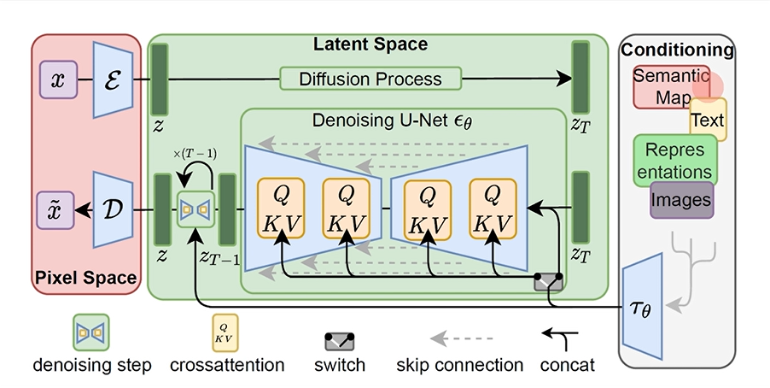

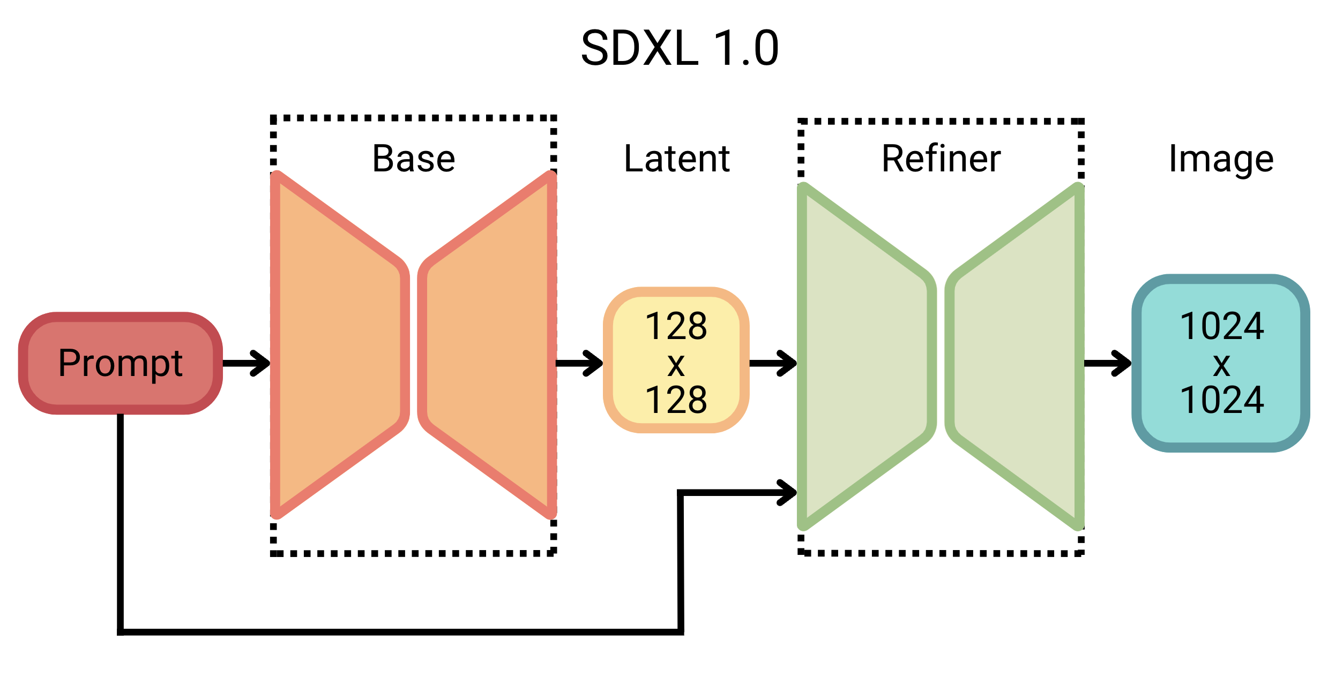
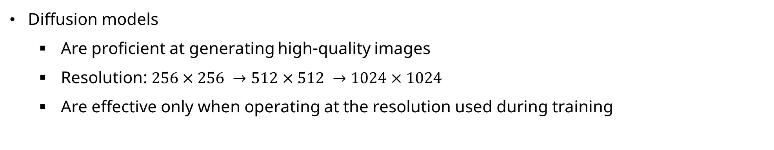
Problem Definition
Diffusion models
Are proficient at generating high-quality images
Resolution: $256×256 →512×512 →1024×1024$
Are effective only when operating at the resolution used during training

Slide 4
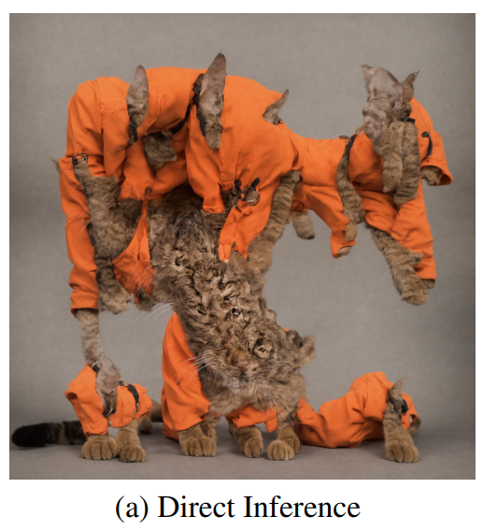
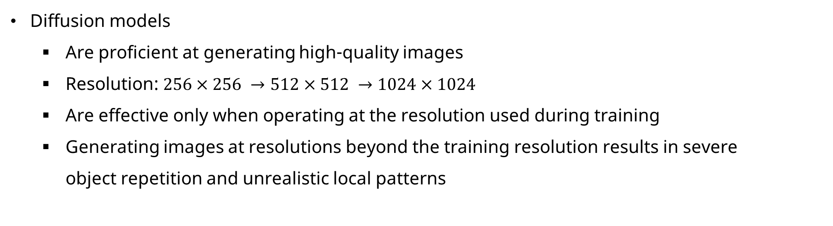
Problem Definition
Diffusion models
Are proficient at generating high-quality images
Resolution: $256×256 →512×512 →1024×1024$
Are effective only when operating at the resolution used during training
Generating images at resolutions beyond the training resolution results in severe object repetition and unrealistic local patterns
SDXL: $1024×1024 →3072×3072$
Prompt: “a cat in an orange work suit”

Slide 5
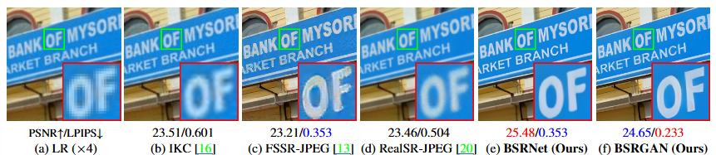
Task: super-resolution
Objective
Reconstruct a high-resolution image from a low-resolution input
Enhance details, sharpness, and overall visual quality beyond the original resolution
Issue
Retraining at higher resolutions quickly becomes prohibitive

Slide 6
Task: super-resolution
Objective
Reconstruct a high-resolution image from a low-resolution input without additional training
Enhance details, sharpness, and overall visual quality beyond the original resolution

Slide 7
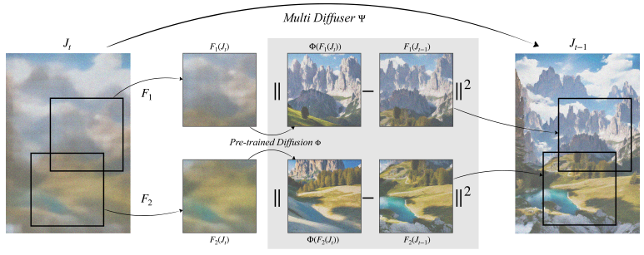
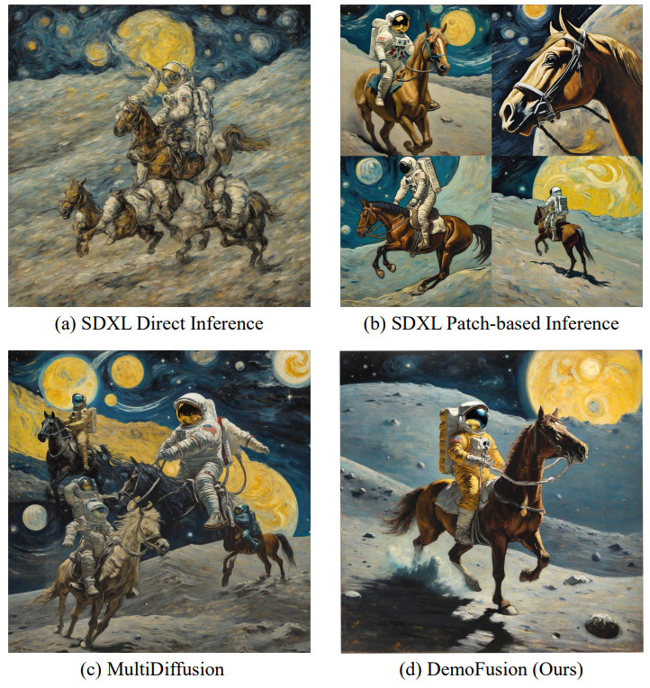
Related work
Early works [1]: use overlapping patches at native resolution and blending the outputs
Patch-based mechanism
Lead to frequent repetitions and inconsistent global image structure
Subsequent works [2]: patch-based mechanism with skip residuals
[1]
[1]
[2]
[1] Bar-Tal, Omer, et al. "Multidiffusion: Fusing diffusion paths for controlled image generation." (2023).
[2] Du, Ruoyi, et al. "Demofusion: Democratising high-resolution image generation with no $$$." Proceedings of the IEEE/CVF conference on computer vision and pattern recognition. 2024.

Slide 8
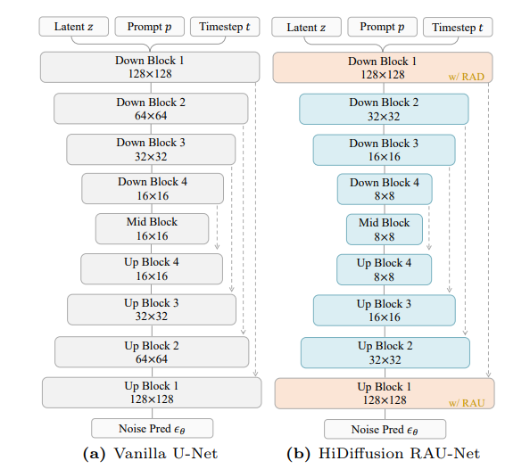
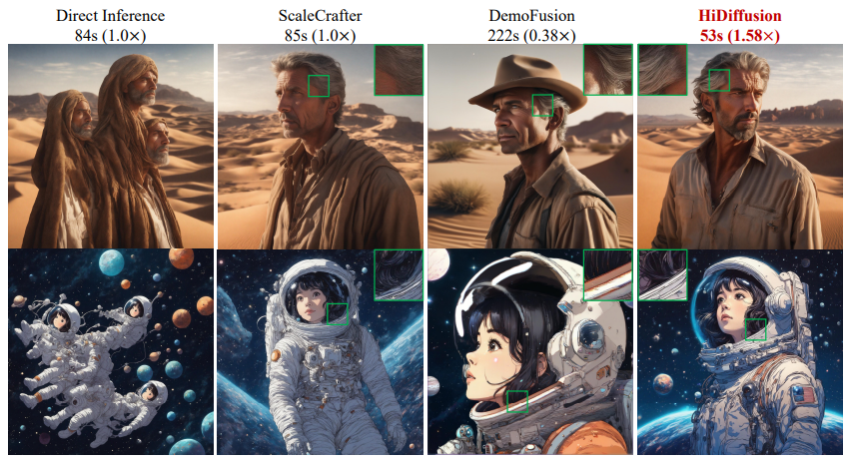
Related work
Subsequent works [2]: patch-based mechanism with skip residuals
Still suffer from issues like local repetitions and inconsistent global coherence
Also have significant overheads due to multiple reverse passes
Other works [3]: mitigate the high latencies
Generate high-resolution images in a single pass by modifying the architecture of UNet
[3]
[2]
[3]
[2] Du, Ruoyi, et al. "Demofusion: Democratising high-resolution image generation with no $$$." CVPR 2024.
[3] Zhang, Shen, et al. "Hidiffusion: Unlocking higher-resolution creativity and efficiency in pretrained diffusion models." European Conference on Computer Vision.

Slide 9
Related work
Early works [1]: object repetitions and inconsistent global image structure
Subsequent works [2]: patch-based mechanism with skip residuals
Still suffer from issues like local repetitions and inconsistent global coherence
Also have significant overheads due to multiple reverse passes
Other works [3]: mitigate the high latencies
Generate high-resolution images in a single pass by modifying the architecture of UNet
Result in image distortions
[1] Bar-Tal, Omer, et al. "Multidiffusion: Fusing diffusion paths for controlled image generation." (2023).
[2] Du, Ruoyi, et al. "Demofusion: Democratising high-resolution image generation with no $$$." CVPR 2024.
[3] Zhang, Shen, et al. "Hidiffusion: Unlocking higher-resolution creativity and efficiency in pretrained diffusion models." European Conference on Computer Vision.

Slide 10
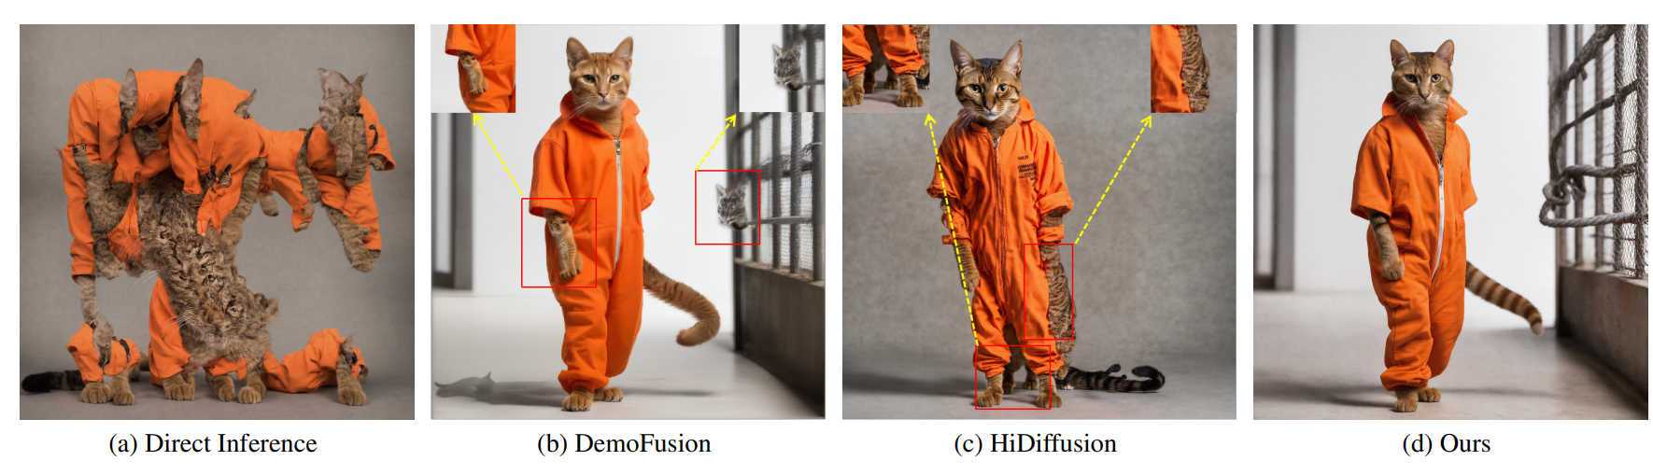
FAM Diffusion
FAM Diffusion addresses structural and local artifacts without additional training and significant latency overheads
[2]
[3]
[2] Du, Ruoyi, et al. "Demofusion: Democratising high-resolution image generation with no $$$." CVPR 2024.
[3] Zhang, Shen, et al. "Hidiffusion: Unlocking higher-resolution creativity and efficiency in pretrained diffusion models." European Conference on Computer Vision.

Slide 11
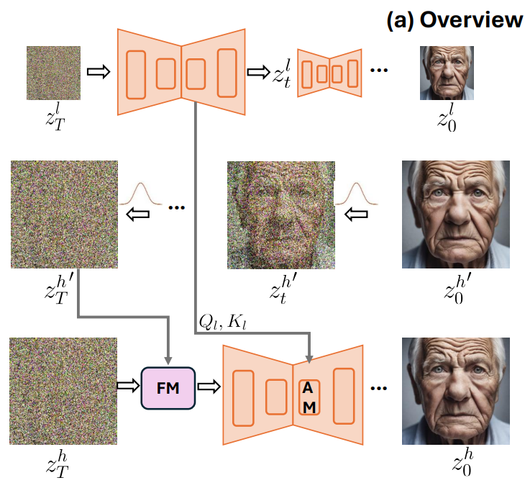
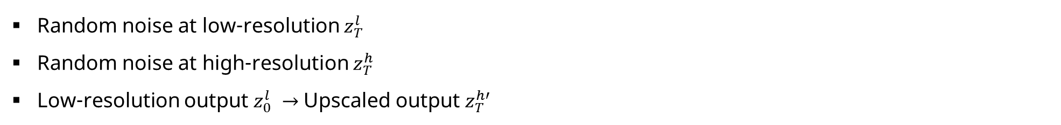
FAM Diffusion
Frequency Modulation (FM): improves global consistency
Attention Modulation (AM): improves the consistency of local texture patterns
Random noise at low-resolution $z_{T}^{l}$
Random noise at high-resolution $z_{T}^{h}$
Low-resolution output $z_{0}^{l} →$Upscaled output $z_{T}^{h′}$

Slide 12
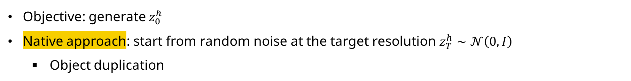
Frequency Modulation (FM): improves global consistency
Objective: generate $z_{0}^{h}$
Native approach: start from random noise at the target resolution $z_{T}^{h}∼𝒩\left(0,I\right)$
Object duplication

Slide 13
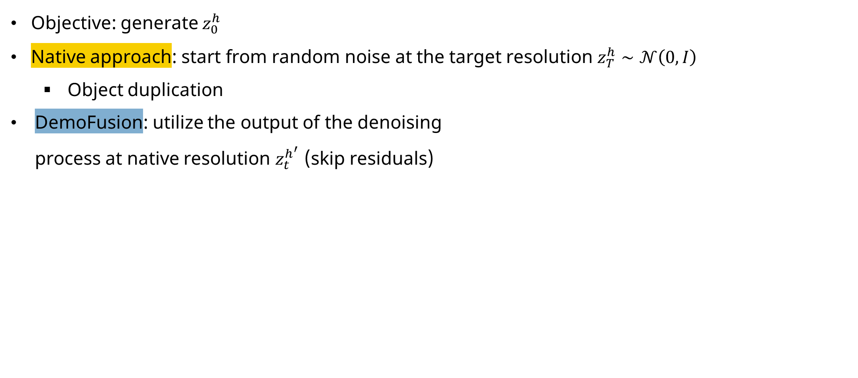
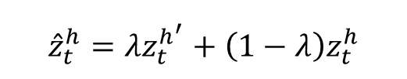
Frequency Modulation (FM): improves global consistency
Objective: generate $z_{0}^{h}$
Native approach: start from random noise at the target resolution $z_{T}^{h}∼𝒩\left(0,I\right)$
Object duplication
DemoFusion: utilize the output of the denoising process at native resolution $z_{t}^{h^{′}}$ (skip residuals)
$${\hat{z}}_{t}^{h}=λz_{t}^{h^{′}}+\left(1−λ\right)z_{t}^{h}$$

Slide 14
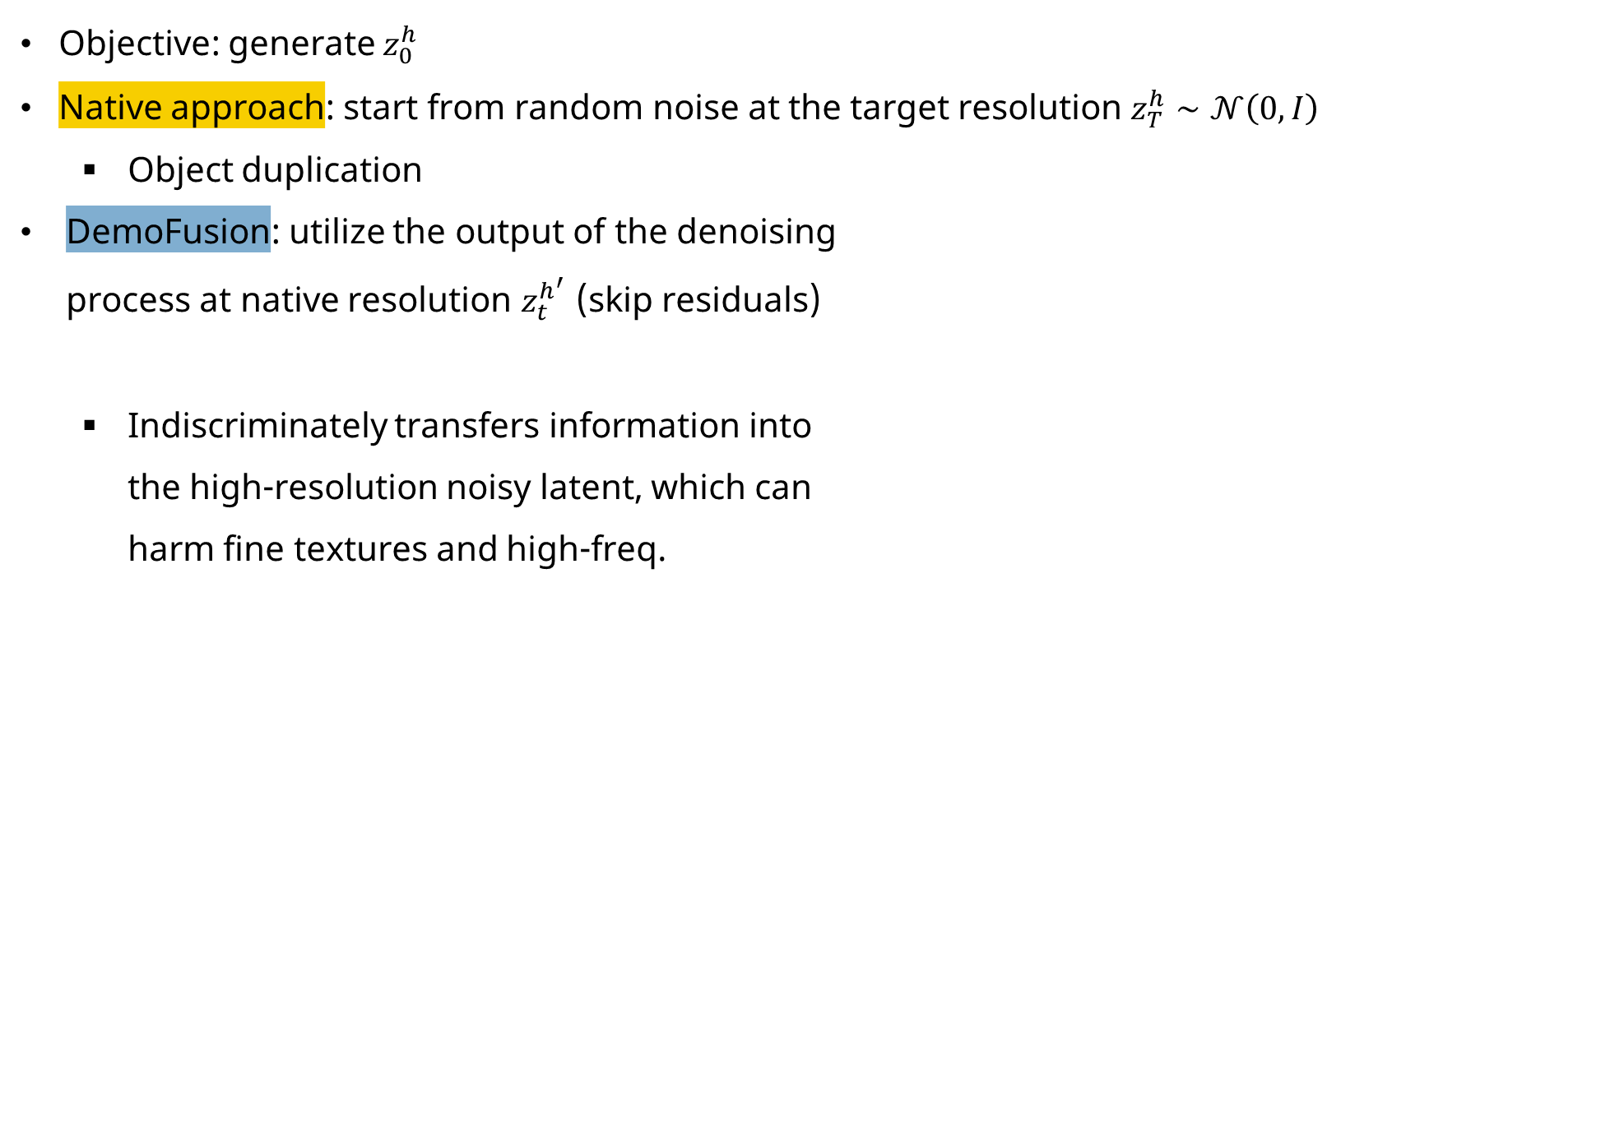
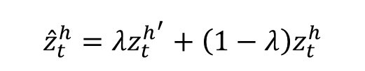
Frequency Modulation (FM): improves global consistency
Objective: generate $z_{0}^{h}$
Native approach: start from random noise at the target resolution $z_{T}^{h}∼𝒩\left(0,I\right)$
Object duplication
DemoFusion: utilize the output of the denoising process at native resolution $z_{t}^{h^{′}}$ (skip residuals)
Indiscriminately transfers information into the high-resolution noisy latent, which can harm fine textures and high-freq.
$${\hat{z}}_{t}^{h}=λz_{t}^{h^{′}}+\left(1−λ\right)z_{t}^{h}$$

Slide 15
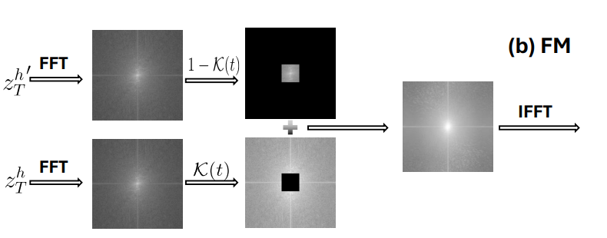
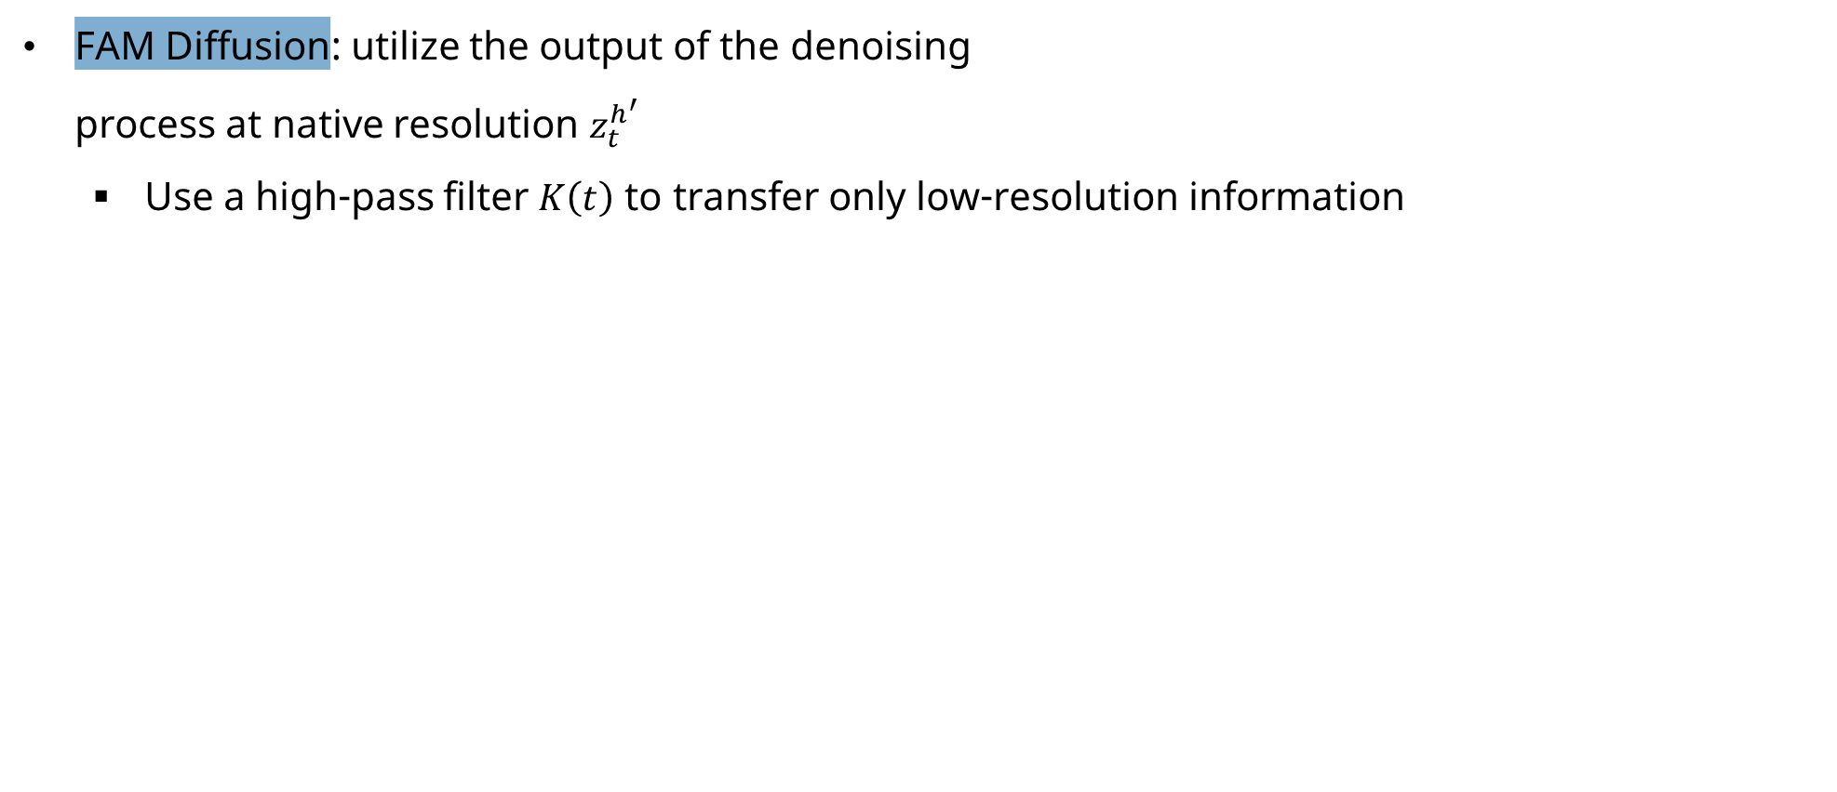
Frequency Modulation (FM): improves global consistency
FAM Diffusion: utilize the output of the denoising process at native resolution $z_{t}^{h^{′}}$
Use a high-pass filter $K\left(t\right)$ to transfer only low-resolution information
${\hat{z}}_{t}^{h} = IDFT_{2D}(K\left(t\right)⊙DFT_{2D}(z_{t}^{h}) + (1−$ $K(t)) ⊙DFT_{2D}(z_{t}^{h′}))$

Slide 16
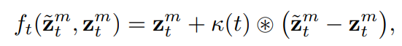


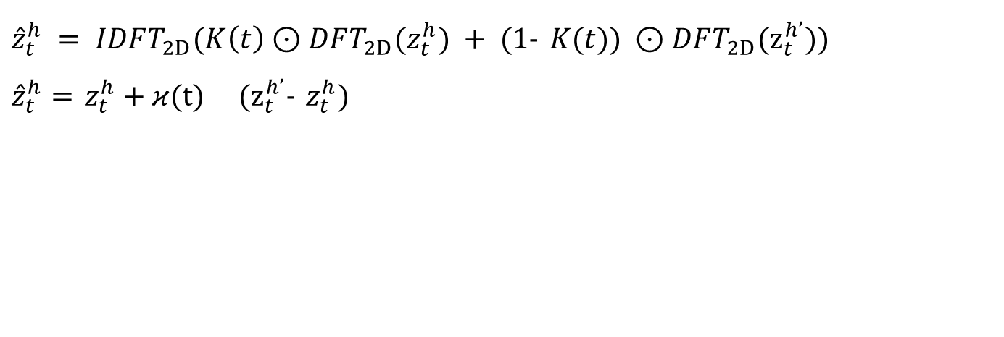
Frequency Modulation (FM): improves global consistency
FAM Diffusion: utilize the output of the denoising process at native resolution $z_{t}^{h^{′}}$
Use a high-pass filter $K\left(t\right)$ to transfer only low-freqeuncy
$$κ\left(t\right)=IDFT_{2D}\left(1−K\left(t\right)\right)$$
: circular convolution
${\hat{z}}_{t}^{h} = IDFT_{2D}(K\left(t\right)⊙DFT_{2D}(z_{t}^{h}) + (1−$ $K(t)) ⊙DFT_{2D}(z_{t}^{h’}))$
${\hat{z}}_{t}^{h}=$ $z_{t}^{h}+κ(t) (z_{t}^{h’}−$ $z_{t}^{h})$

Slide 17
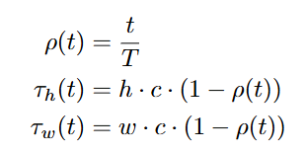
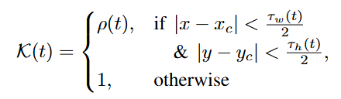


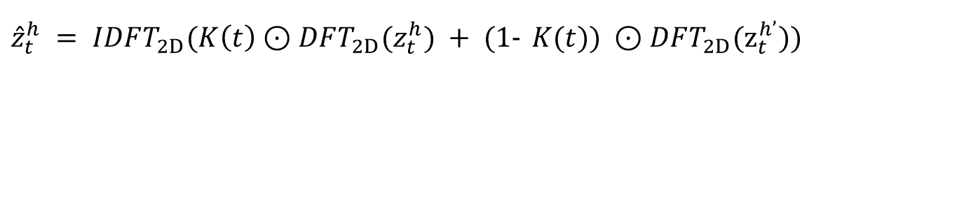
Frequency Modulation (FM): improves global consistency
FAM Diffusion: utilize the output of the denoising process at native resolution $z_{t}^{h^{′}}$
Use a high-pass filter $K\left(t\right)$
${\hat{z}}_{t}^{h} = IDFT_{2D}(K\left(t\right)⊙DFT_{2D}(z_{t}^{h}) + (1−$ $K(t)) ⊙DFT_{2D}(z_{t}^{h’}))$
$$c=0.5$$

Slide 18
Frequency Modulation (FM): improves global consistency
FAM Diffusion: utilize the output of the denoising process at native resolution $z_{t}^{h^{′}}$
Use a high-pass filter $K\left(t\right)$
${\hat{z}}_{t}^{h} = IDFT_{2D}(K\left(t\right)⊙DFT_{2D}(z_{t}^{h}) + (1−$ $K(t)) ⊙DFT_{2D}(z_{t}^{h’}))$
$$c=0.5$$

Slide 19
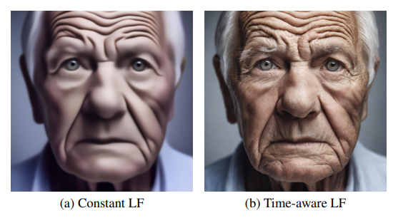
Frequency Modulation (FM): improves global consistency
FAM Diffusion: utilize the output of the denoising process at native resolution $z_{t}^{h^{′}}$
Use a high-pass filter $K\left(t\right)$
${\hat{z}}_{t}^{h} = IDFT_{2D}(K\left(t\right)⊙DFT_{2D}(z_{t}^{h}) + (1−$ $K(t)) ⊙DFT_{2D}(z_{t}^{h’}))$

Slide 20
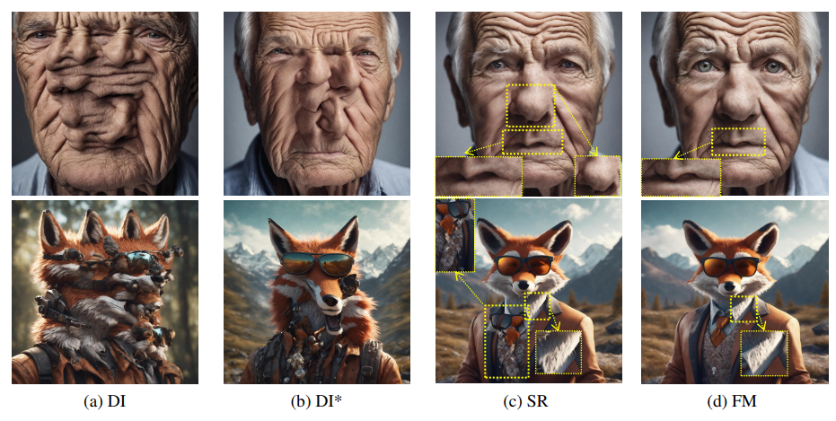
Attention Modulation (AM): improves local texture
FM module successfully maintains global structure and solves the issue of object duplication
However, the high-frequency detail generated on the shirt collar is related to fox’s face

Slide 21
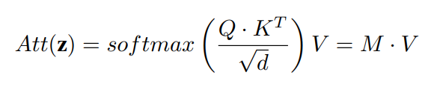
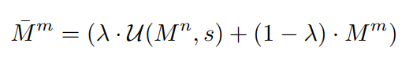
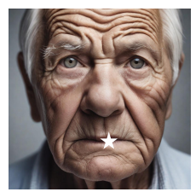
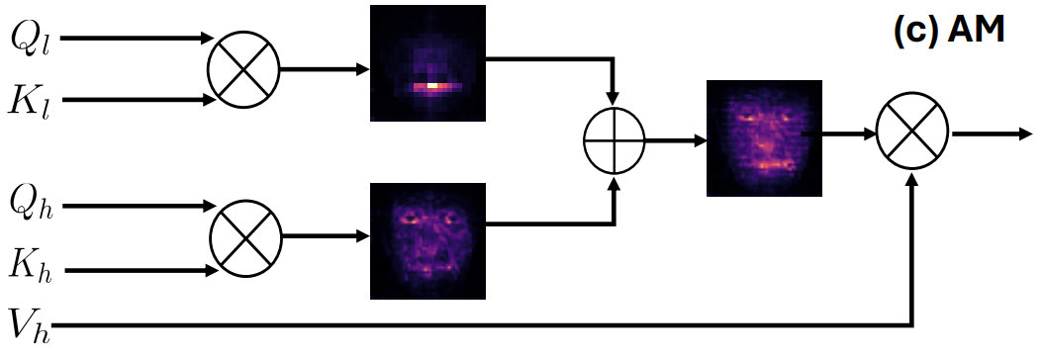
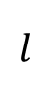
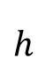
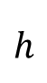
Attention Modulation (AM): improves local texture
Hypothesize this stems from incorrect attention maps during the high-res denoising stage
$$h$$
$$l$$
$$h$$
Low
High

Slide 22
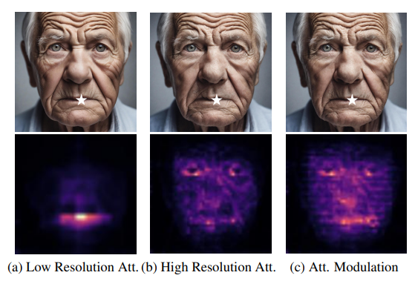
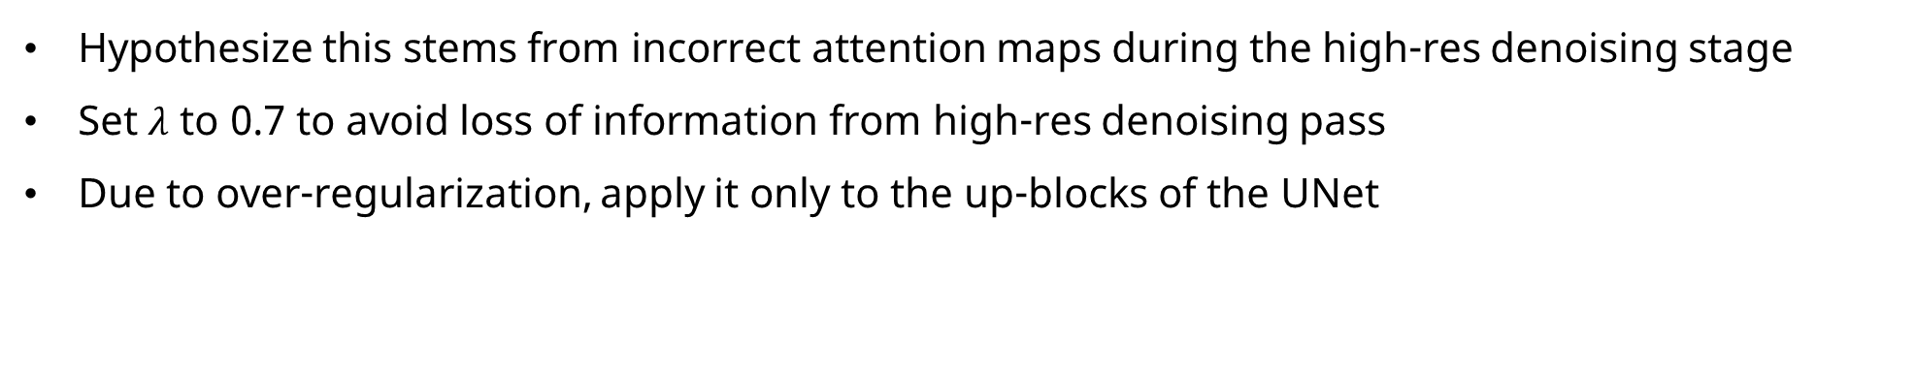
Attention Modulation (AM): improves local texture
Hypothesize this stems from incorrect attention maps during the high-res denoising stage
Set $λ$ to 0.7 to avoid loss of information from high-res denoising pass
Due to over-regularization, apply it only to the up-blocks of the UNet
Low
High

Slide 23
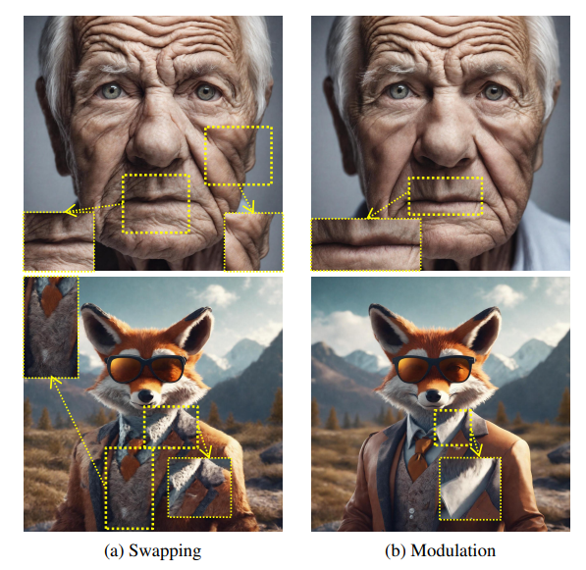
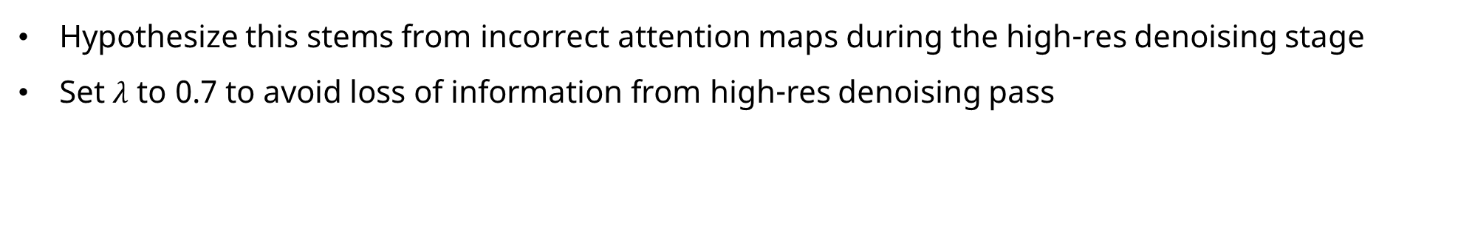
Attention Modulation (AM): improves local texture
Hypothesize this stems from incorrect attention maps during the high-res denoising stage
Set $λ$ to 0.7 to avoid loss of information from high-res denoising pass
$$h$$
$$l$$
$$h$$
Low
High

Slide 24
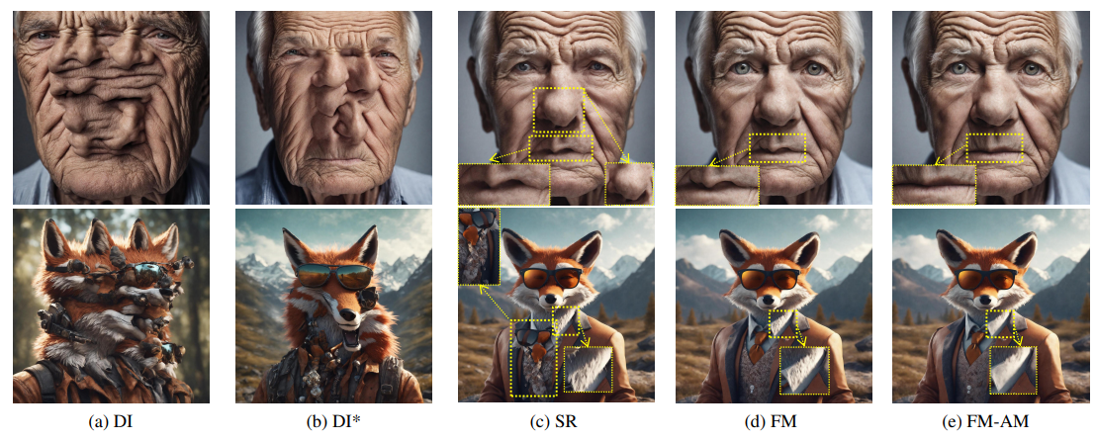
Attention Modulation (AM): improves local texture
Hypothesize this stems from incorrect attention maps during the high-res denoising stage
Set $λ$ to 0.7 to avoid loss of information from high-res denoising pass

Slide 25
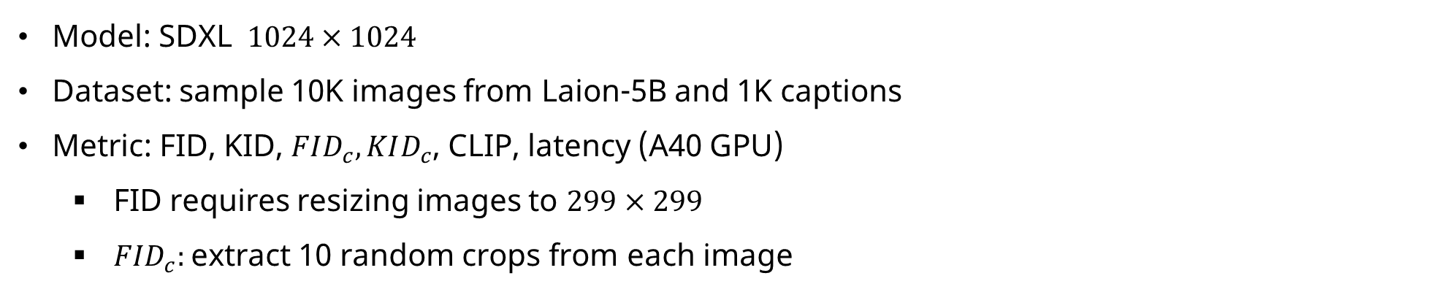
Setup
Model: SDXL $1024×1024$
Dataset: sample 10K images from Laion-5B and 1K captions
Metric: FID, KID, $FID_{c}, KID_{c}$, CLIP, latency (A40 GPU)
FID requires resizing images to $299×299$
${FID}_{c}:$extract 10 random crops from each image

Slide 26
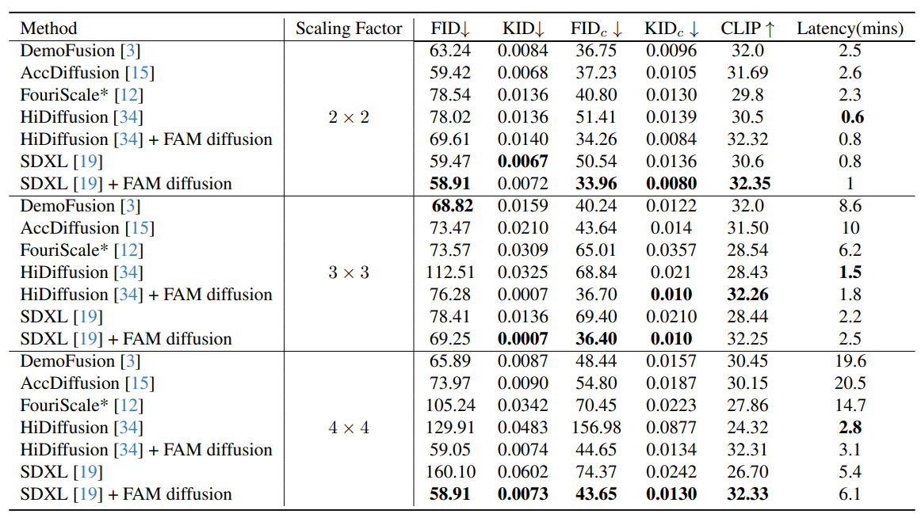
Main results
Achieves the best performance across $FID_{c}, KID_{c},$ and CLIP scores
Shows robustness in FID and KID even as the scale factor increases

Slide 27
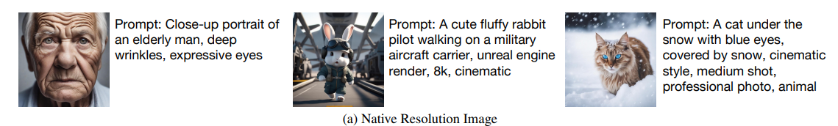
Main results

Slide 28
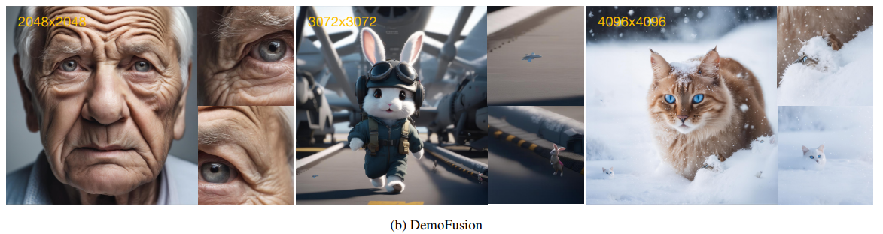
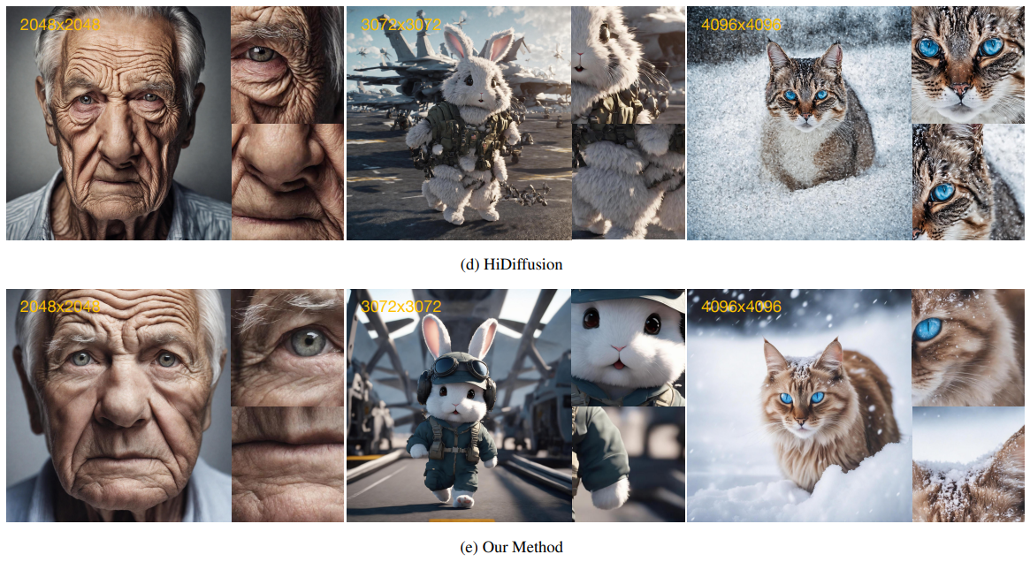

Slide 29
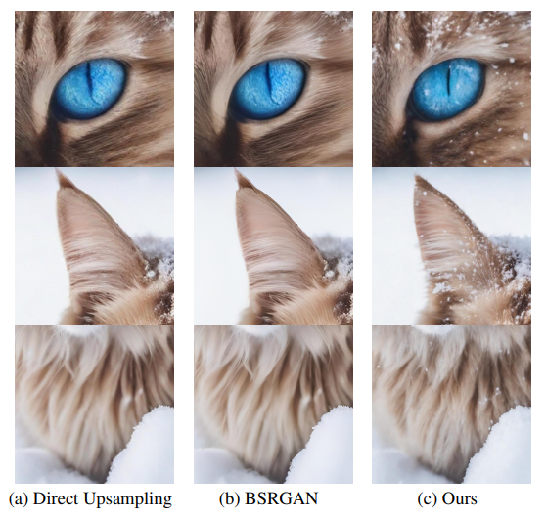
VS Super resolution approach
FAM Diffusion modifies high-frequency details that were not present in the original image
Leading more appealing and detailed images

Slide 30
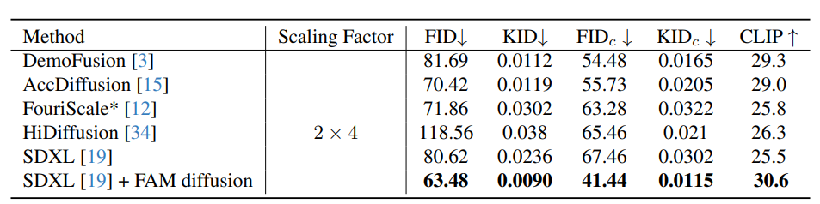
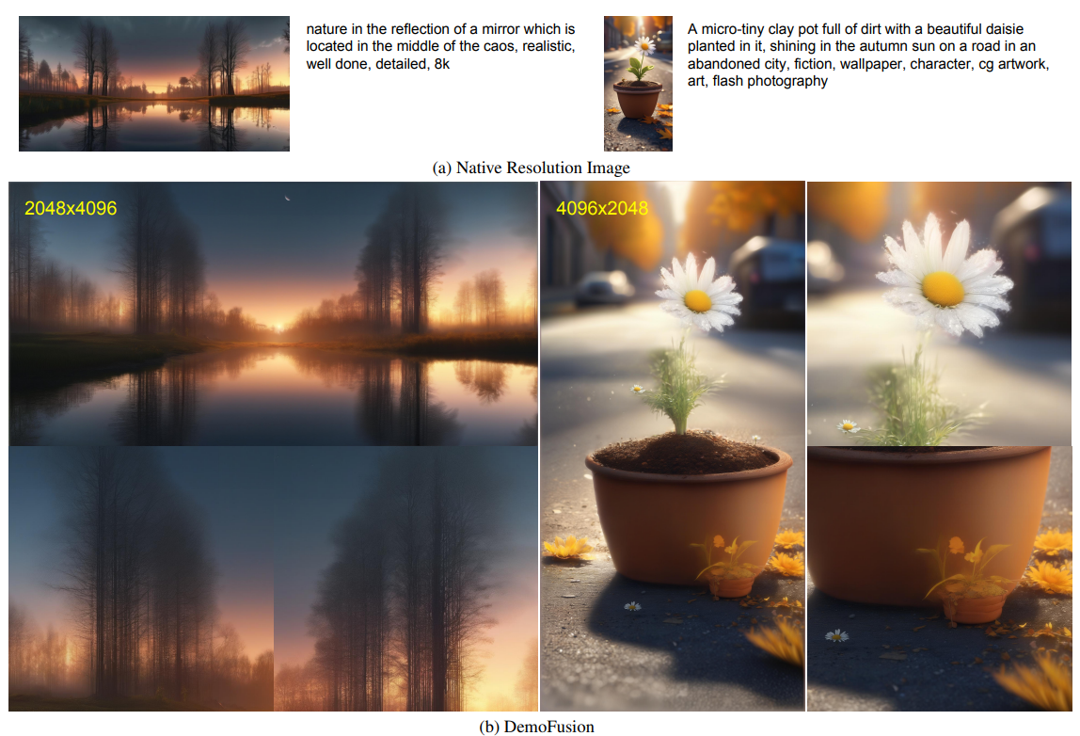
Different aspect ratio

Slide 31
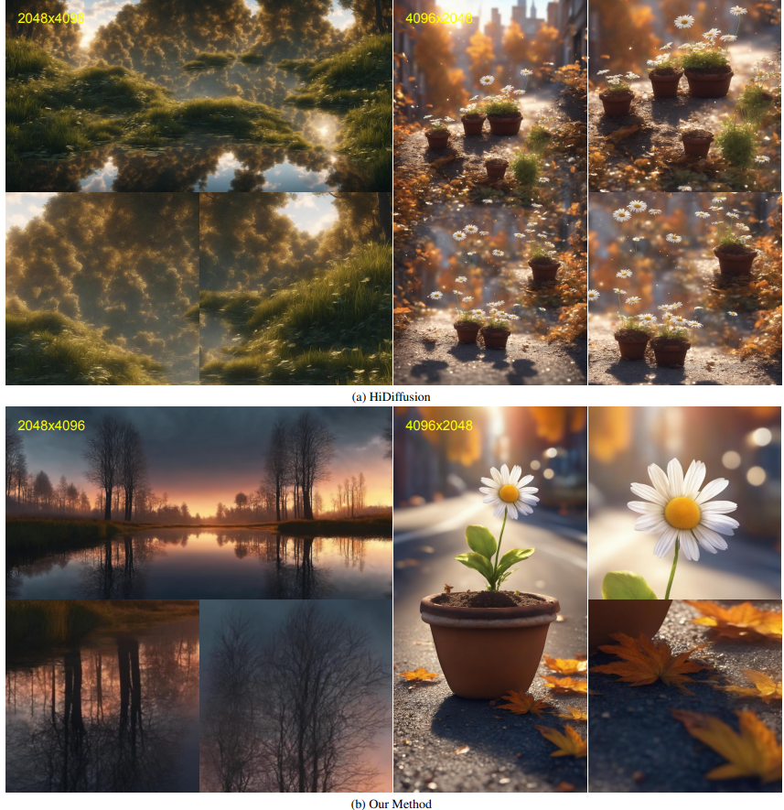
Different aspect ratio

Slide 32
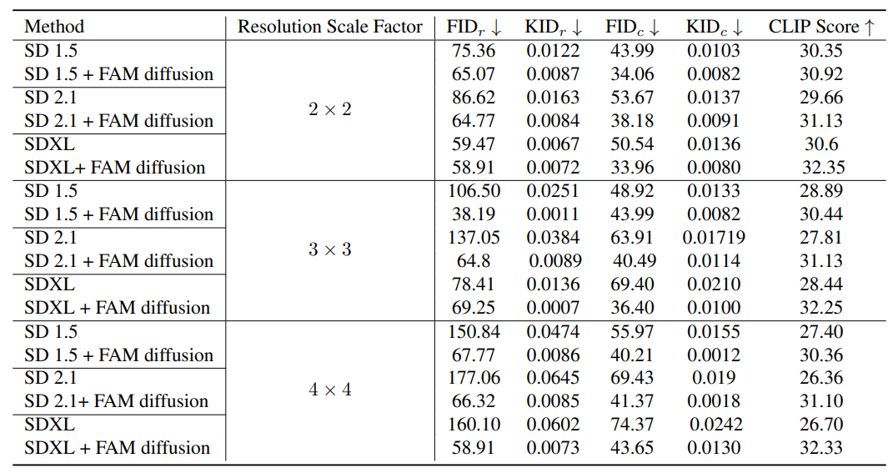
Different SD backbones
Remains robust to the scaling factor

